Slide 1
Gene-environment Interactions: Part 1: Basic Concepts and GWIS
Jim Gauderman
Division of Biostatistics
Department of Preventive Medicine
University of Southern California
JimG@usc.edu

Slide 2
Overview
Basic concepts of GxE interaction
Candidate gene studies
GWIS
Power and sample size
Software for GWIS analysis

Slide 3
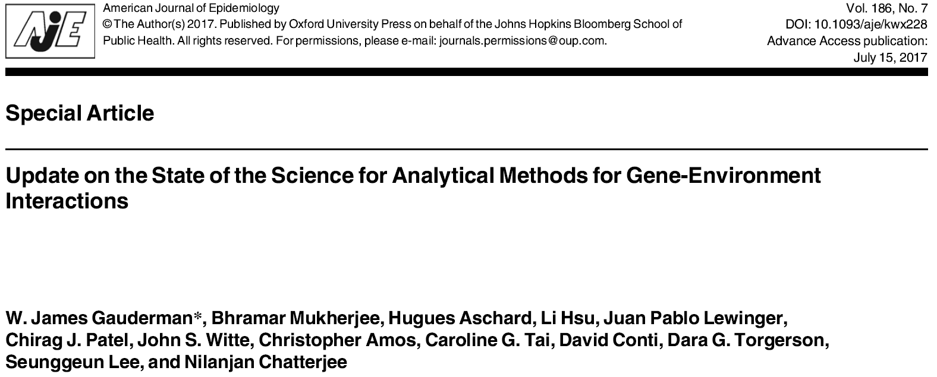
One of a multi-part series of papers on GxE interactions in the same issue

Slide 4
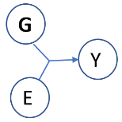
Reasons to Consider GxE
We want to understand something about etiology or underlying biology
e.g. Environmental exposures and genes in the oxidative stress pathway
We want to build better prognostic models
e.g. Use genotype to inform choice of treatment or dietary recommendations

Slide 5
Reasons to Consider GxE
G is important and we want to identify possible higher-penetrance subgroups
Is the BRCA1 → Breast Cancer association stronger in pre-menopausal women?
E is important and we want to identify potentially susceptible subgroups
Is the Air Pollution → Asthma association stronger in those with GSTM1 null genotype?

Slide 6
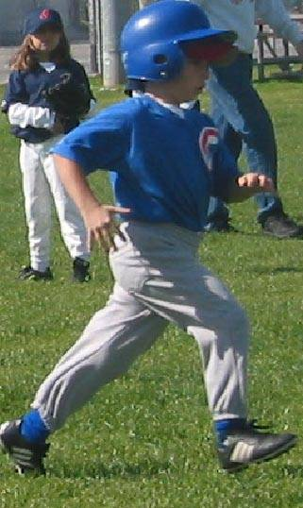
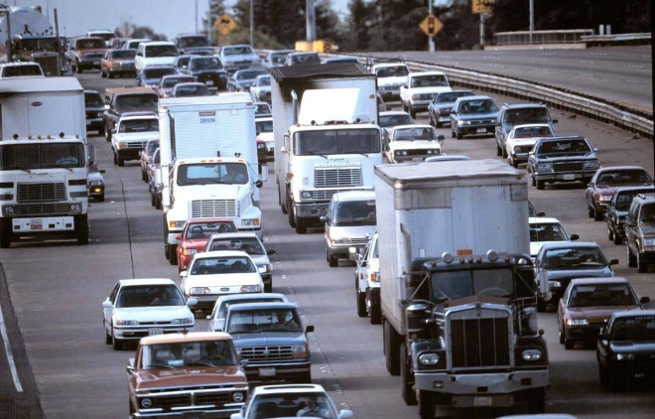
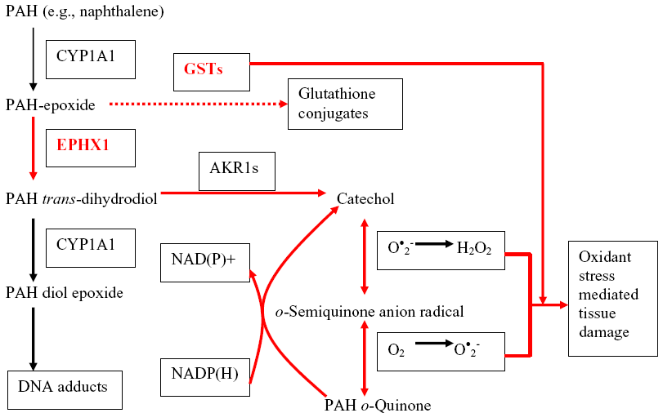
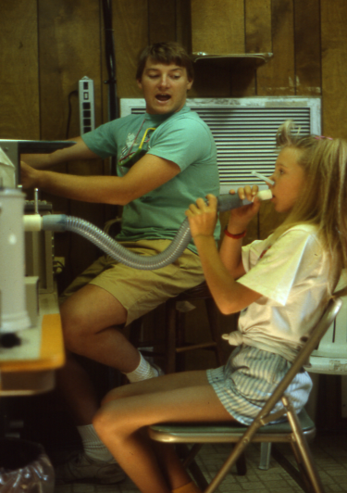
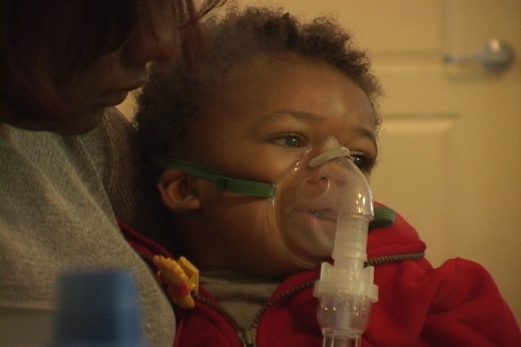
The USC Children’s Health Study
John Peters
Ed Avol
Kiros Berhane
Carrie Breton
JC Chen
Scott Fruin
Jim Gauderman
Frank Gilliland
Talat Islam
Fred Lurmann
Rob McConnell
Duncan Thomas

Slide 7
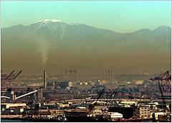
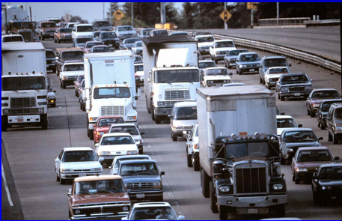


Does breathing air pollutants cause respiratory
health effects in children?
Regional Pollution
Local Pollution
Environmental Tobacco Smoke

Slide 8
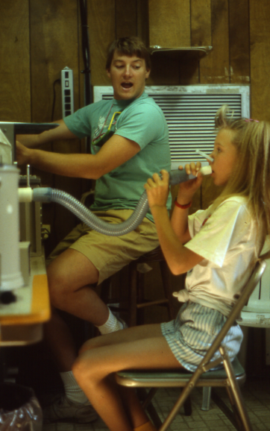


Available Data
11,365 school-aged children
Outcomes
Annual lung function, asthma, respiratory symptoms
DNA
Genotyping at candidate loci and genomewide
Exposures
Air pollution, traffic, smoking

Slide 9
CHS: OR’s for GSTM1 and in-utero smoke
N=2,750 CHS children

Slide 10
GxE Interaction and Asthma
(Gilliland et al., 2002, AJRCCM)

Slide 11
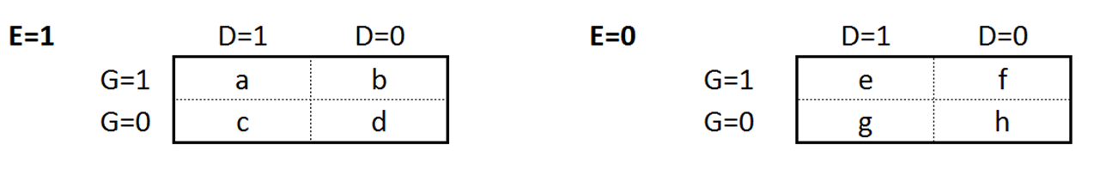
GxE: A Little Math

Slide 12
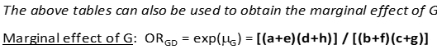
GxE: A Little Math
logit(Pr D=1|G, E) = α + β_{G}G + β_{E}E + β_{GxE}G*E
H₀: β_{GxE} = 0 (standard 1-df test of GxE)
logit(Pr D=1|G, E) = α + μ_{G}G
H₀: μ_{G}=0 (standard 1-df test of G)

Slide 13
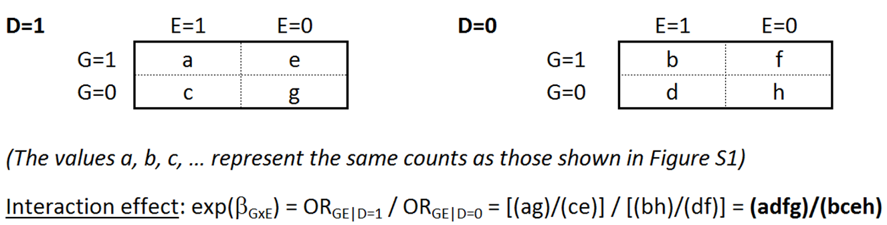
GxE: A Little Math

Slide 14
GxE: A Little Math

Slide 15
GxE: A Little Math
logit(Pr G=1|D, E) = α + β_{D}D + β_{E}E + β_{DxE}D*E
H₀: β_{DxE} = 0 (equivalent to standard 1-df test of β_{GxE})

Slide 16
GxE: A Little Math
(bh)/(fd) ≈ 1.0?

Slide 17
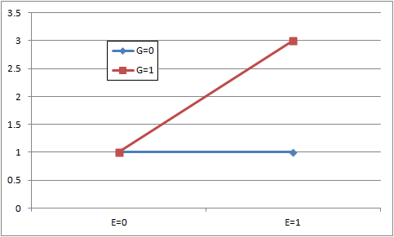
Graphing an Interaction
Odds Ratio

Slide 18
Graphing an Interaction
Required N can be Large
Odds Ratio

Slide 19
Quanto
https://pphs.usc.edu/biostatistics-software/
Gauderman and Morrison
Power and Sample Size Calculations
Several Study Designs

Slide 20
Quanto
https://pphs.usc.edu/biostatistics-software/
Gauderman and Morrison
Several hypotheses

Slide 21
Example: Unmatched case-control (1:1)
Required N (case-control pairs) to detect GxE
80% power, α=0.05, one G

Slide 22
Case-control vs. Case-only Design
Required N to detect GxE (Case-control / Case-only)

Slide 23
Genomewide Association Studies
We want to find this one
How do we do it?
Test disease vs. each marker
Impute each and test vs. outcome
Most GWA studies only test marginal G effects
Causal SNP
…
…

Slide 24
What Are We Missing?
SNPs with modest marginal effect that might be important in one or more subgroups?

Slide 25
What Are We Missing?
SNPs with modest marginal effect that might be important in one or more subgroups?
Size of the marginal G effect depends on prevalence of exposure
Marginal G effect
50% Exposed

Slide 26
What Are We Missing?
SNPs with modest marginal effect that might be important in one or more subgroups?
Size of the marginal G effect depends on prevalence of exposure
Marginal G effect
75% Exposed

Slide 27
What Are We Missing?
SNPs with modest marginal effect that might be important in one or more subgroups?
Size of the marginal G effect depends on prevalence of exposure
Marginal G effect
25% Exposed

Slide 28
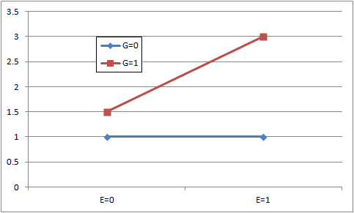
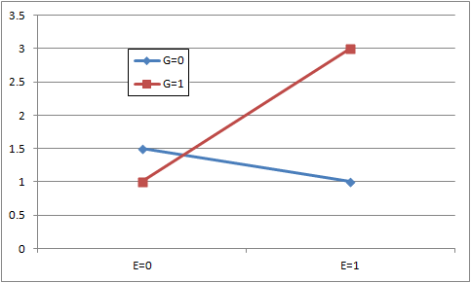
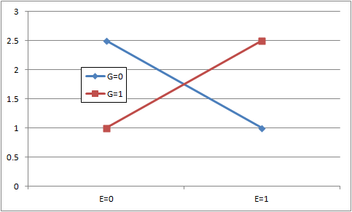
What Are We Missing?
SNPs with modest marginal effect that might be important in one or more subgroups?
SNPs with little or no marginal effect due to opposite effects in subgroups?

Slide 29
Sample size: One GxE vs. a GWIS
Required # case-control pairs α = 0.05 / α = 5×10⁻⁸

Slide 30
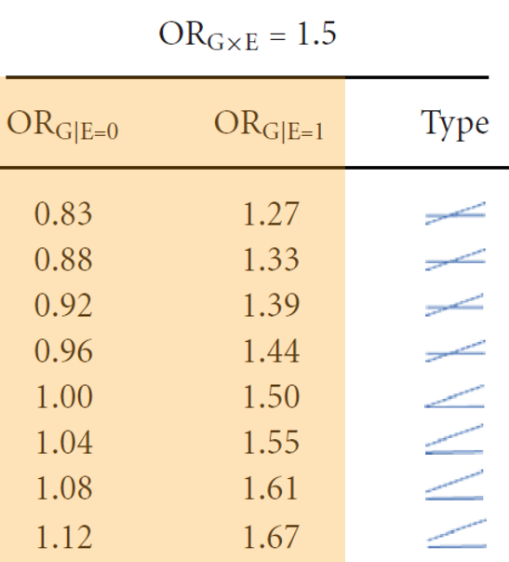
Exposure-specific G effects that all produce an OR_{GxE} of 1.5

Slide 31
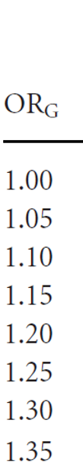
Exposure-specific G effects that all produce an OR_{GxE} of 1.5
Not detectable in standard GWAS
Detectable in GWAS?

Slide 32
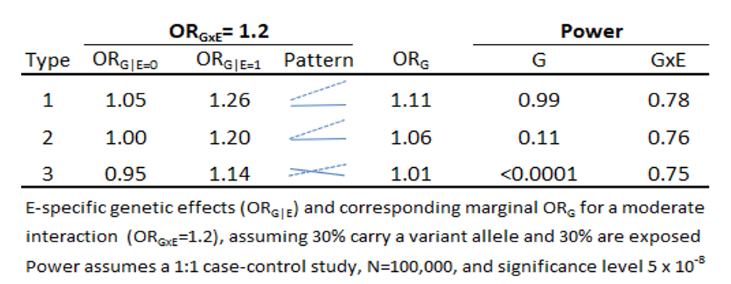
Power to detect a SNP with OR_{GxE}=1.2 in a GWAS and GWIS
(with 3 different patterns of GxE interaction)

Slide 33
Improving GWIS Efficiency: The Basic Idea
For logistic regression of a CC sample:
logit(Pr Y=1|G, E) = α + β_{G}G + β_{E}E + β_{GxE}G*E
the test of H₀:β_{GxE}=0 has low power
There is additional information in a case-control sample about GxE interaction that is not used in the above test

Slide 34
In the Presence of GxE…
Induced “Marginal”:
G to D association
G to E association
‘case-only’ style association
Observed in combined case-control sample if cases are oversampled relative to population prevalence
Can we use this extra info to construct more efficient GW interaction scans?
Marginal G effect

Slide 35
2-step Approach: DG|GxE (Kooperberg and LeBlanc, 2008)
Step 1: Genomewide screen of M SNPs using ‘marginal-effect’ test on all subjects
Logit[Pr(D=1 | G) = μ₀ + μ₁G
Test H_{o}: μ₁=0 for each SNP at α_{M} level

Slide 36
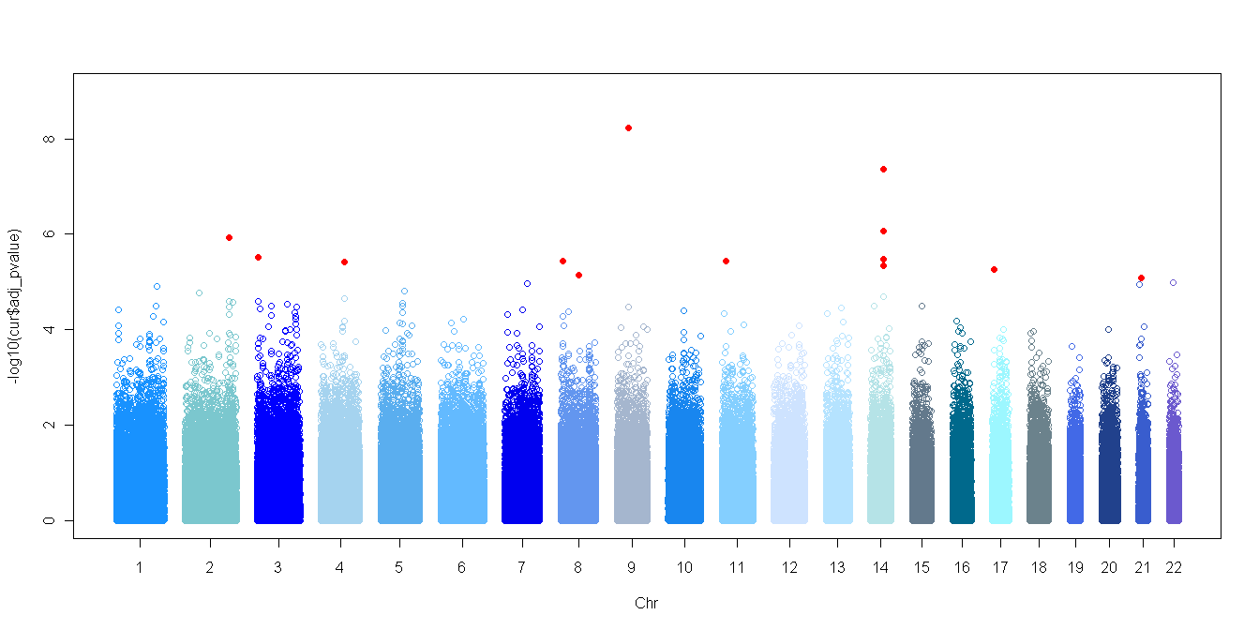
2-step Approach: DG|GxE (Kooperberg and LeBlanc, 2008)
Step 1: Genomewide screen of M SNPs using ‘marginal-effect’ test on all subjects
Logit[Pr(D=1 | G) = μ₀ + μ₁G
Test H_{o}: μ₁=0 for each SNP at α_{M} level
α_{M}

Slide 37
2-step Approach: DG|GxE (Kooperberg and LeBlanc, 2008)
Step 1: Genomewide screen of M SNPs using ‘marginal-effect’ test on all subjects
Logit[Pr(D=1 | G) = μ₀ + μ₁G
Test H_{o}: μ₁=0 for each SNP at α_{M} level
Step 2: For m SNPs with Step-1 p < α_{M} , standard GxE analysis:
Logit[Pr(D=1 | G) = β₀ + β_{G}G + β_{E}E + β_{GxE}GxE
Test H_{o}: β_{GxE}=0 for the m SNPs at α/m level

Slide 38
2-step Approach: EG|GxE (Murcray et al., 2009)
Step 1: Genomewide screen of M SNPs using ‘E vs. G’ test on all subjects
Logit[Pr(E=1 | G) = γ₀ + γ₁G
Test H_{o}: γ₁=0 for each SNP at α_{M} level

Slide 39
2-step Approach: EG|GxE (Murcray et al., 2009)
Step 1: Genomewide screen of M SNPs using ‘G vs. E’ test on all subjects
Logit[Pr(E=1 | G) = γ₀ + γ₁G
Test H_{o}: γ₁=0 for each SNP at α_{M} level
Step 2: For m SNPs with Step-1 p < α_{M} , standard GxE analysis:
Logit[Pr(D=1 | G) = β₀ + β_{G}G + β_{E}E + β_{GxE}GxE
Test H_{o}: β_{GxE}=0 for the m SNPs at α/m level

Slide 40
2-step Approach: EDGE (Gauderman et al., 2013)
Step 1: Genomewide screen of M SNPs using both ‘D vs. G’ and ‘E vs. G’ information
T_{EG} based on E vs G (Murcray et al.)
T_{DG} based on D vs G (Kooperberg & LeBlanc)
→ Screening Test: T_{EgDg} = T_{EG} + T_{DG} (2-df test)

Slide 41
2-step Approach: EDGE (Gauderman et al., 2013)
Step 1: Genomewide screen of M SNPs using both ‘D vs. G’ and ‘E vs. G’ information
T_{EG} based on E vs G (Murcray et al.)
T_{DG} based on D vs G (Kooperberg & LeBlanc)
→ Screening Test: T_{EgDg} = T_{EG} + T_{DG} (2-df test)
Step 2: For m SNPs with Step-1 p < α_{M} , standard GxE analysis:
Logit[Pr(D=1 | G) = β₀ + β_{G}G + β_{E}E + β_{GxE}GxE
Test H_{o}: β_{GxE}=0 for the m SNPs at α/m level

Slide 42
2-step Approach: EDGE (Gauderman et al., 2013)
Step 1: Genomewide screen of M SNPs using both ‘D vs. G’ and ‘E vs. G’ information
T_{EG} based on E vs G (Murcray et al.)
T_{DG} based on D vs G (Kooperberg & LeBlanc)
→ Screening Test: T_{EgDg} = T_{EG} + T_{DG} (2-df test)
Step 2: For m SNPs with Step-1 p < α_{M} , standard GxE analysis:
Logit[Pr(D=1 | G) = β₀ + β_{G}G + β_{E}E + β_{GxE}GxE
Test H_{o}: β_{GxE}=0 for the m SNPs at α/m level
2-step
“Subset” Testing

Slide 43
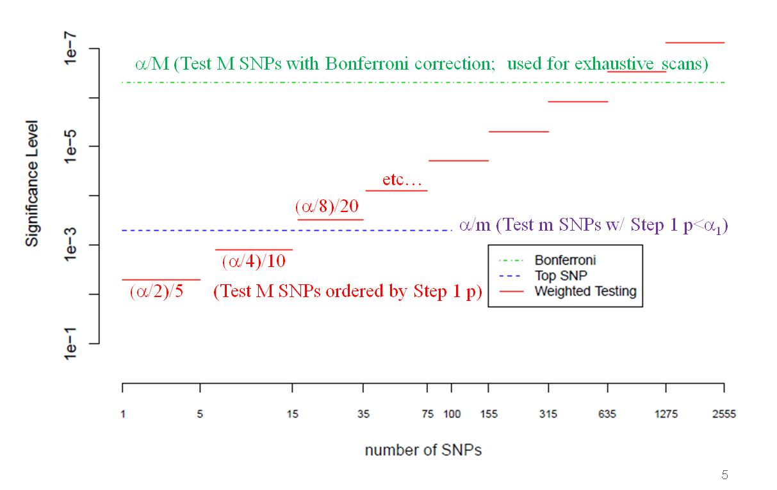
“Weighted Testing” in Step 2
(Ionita-Laza, 2009)
Standard GWIS
2-step with subset testing
Figure adapted from Hsu et al., 2012

Slide 44
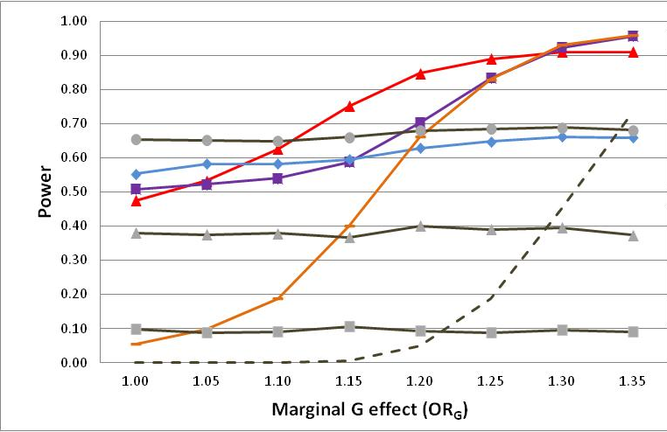
Genomewide Power to Detect OR_{GxE}=1.5 (N=3,500 cases, 3,500 controls)
(Gauderman et al., 2013)
EDGE
EDGE
EG
Case Only
DG
GWAS
GWIS
Notes:
Take home messages for this figure: Power of 2-step methods depend on magnitude of marginal G effect, and there is no universally most powerful method to detect GxE in a GWAS (motivation for implementing multiple methods in GxEscan)

Slide 45
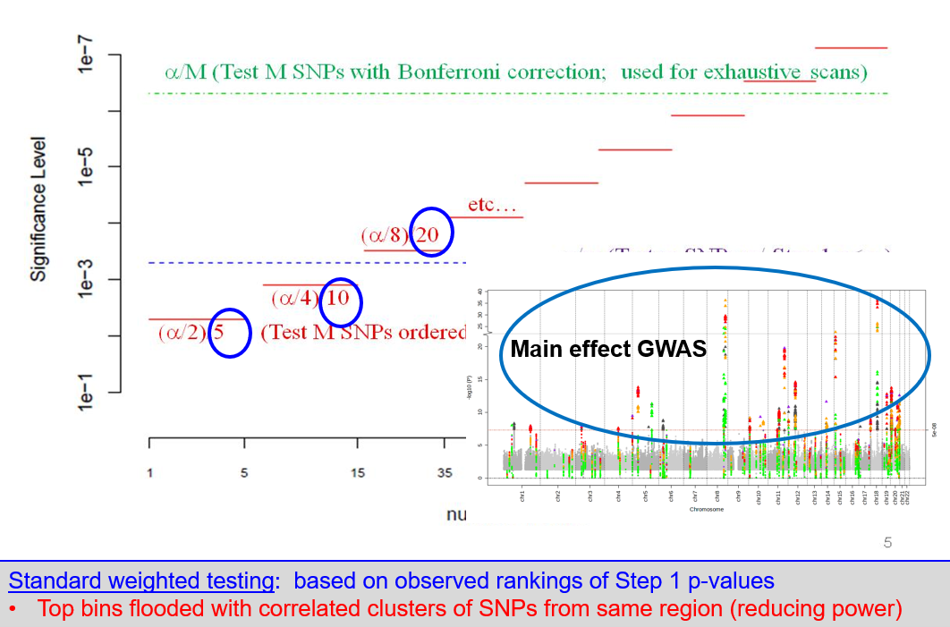
A Problem with Weighted testing?

Slide 46
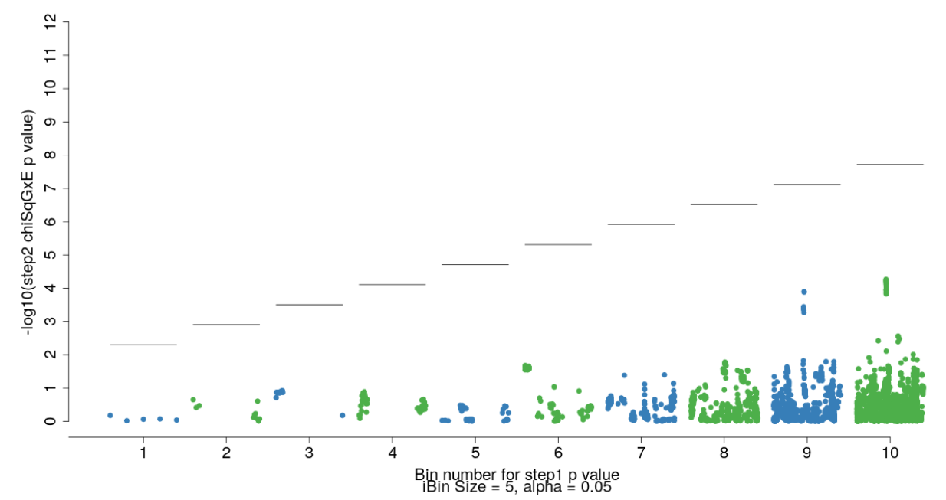
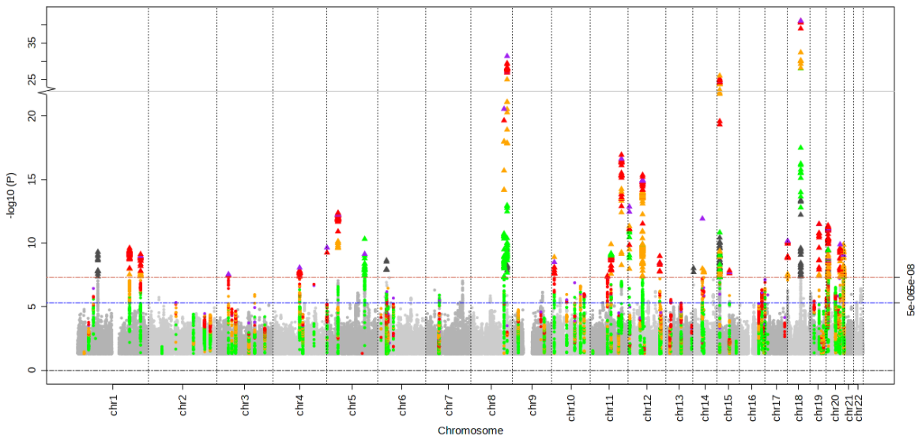
Example: G x Alcohol scan for Colorectal Cancer
Main Effect GWAS (DG association)
Step-2 SNP allocation to bins

Slide 47
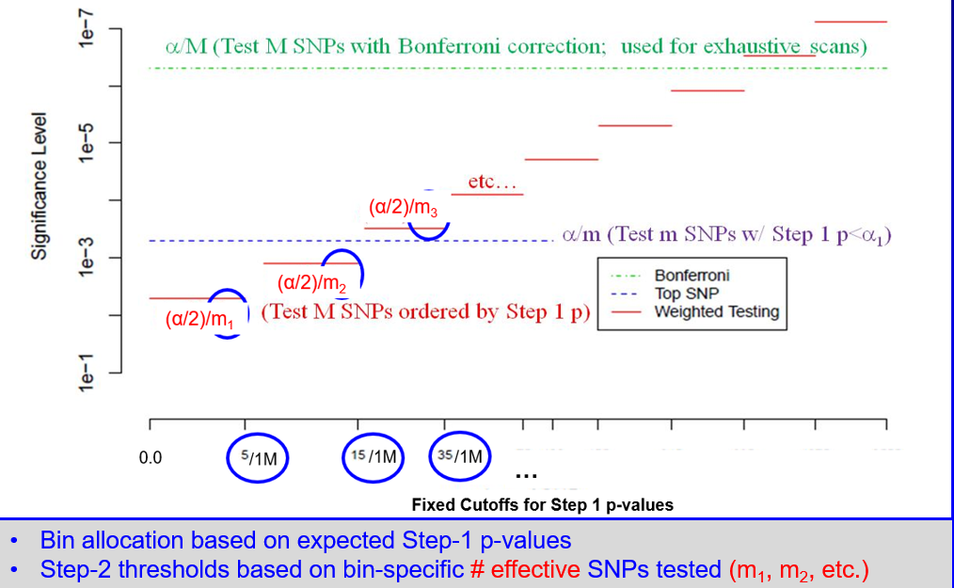
“Weighted-Subset” Testing in Step 2
(Kawaguchi et al., www.biorxiv.org/content/10.1101/2022.06.14.496154v1)

Slide 48
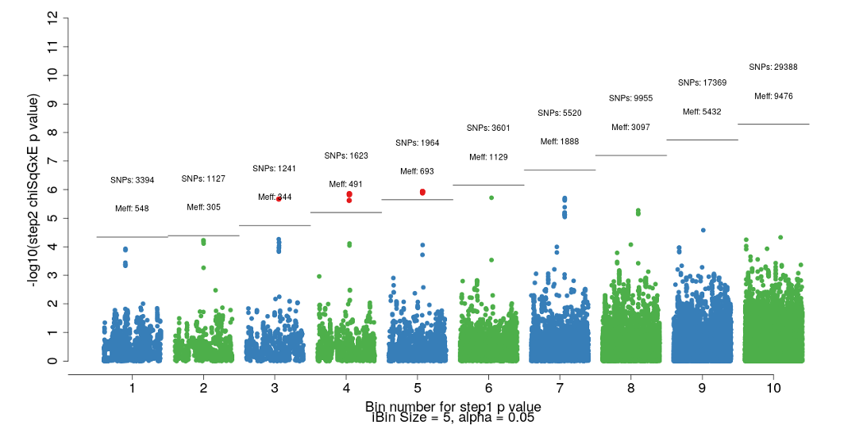
Example: G x Alcohol scan for Colorectal Cancer
Main Effect GWAS (DG association)
Step-2 SNP allocation to bins
Genomewide Significant GxE
Meff computed based on principal components analysis of SNPs within each bin (Gao et al., 2008)

Slide 49
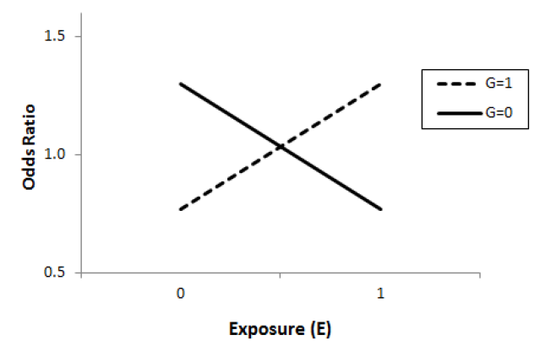
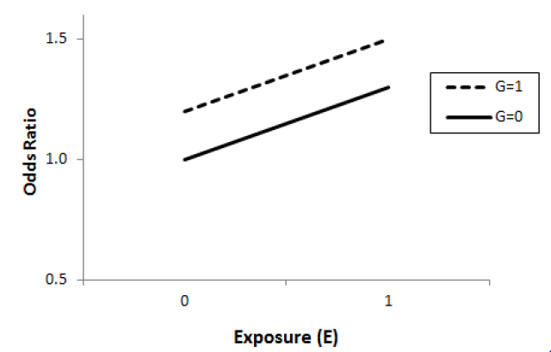
Another way to combine information: The “2-df” joint test
logit(Pr D=1|G, E) = α + β_{G}G + β_{E}E + β_{GxE}G*E
H₀: β_{G} = β_{GxE} = 0 (Joint 2-df test of G, GxE; Kraft et al., 2007)
Can identify loci with …
A GxE effect and induced marginal G effect
A GxE effect but no G effect
A G effect but no GxE effect

Slide 50
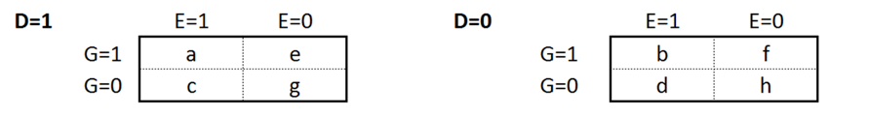
A Joint Model that uses more information
As we have seen, using D-G and E-G information can improve power to detect GxE in a GWIS
What if we treat ‘G’ as the outcome?
β_{D}: G vs. D
β_{E}: G vs. E
β_{DxE}: G vs. DxE (equivalent to D vs. GxE)

Slide 51
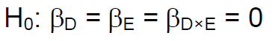
The “3-df” Joint Test
(Gauderman, Kim, Lewinger, Conti, Morrison, Thomas; 2019)
What is it testing?
Marginal G vs. D association (standard GWAS)
Marginal G vs. E association (case-only style G x E)
G x E interaction (standard GWIS)
Potentially powerful for discovery

Slide 52
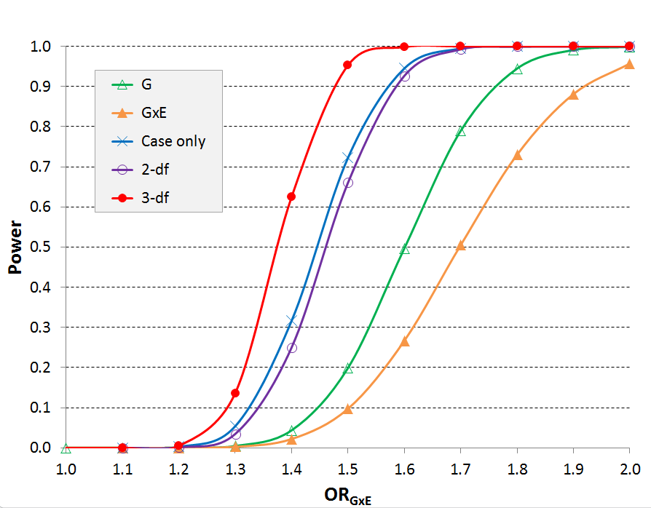
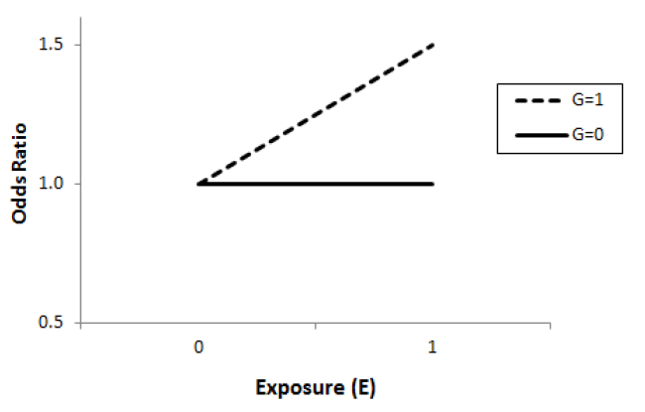
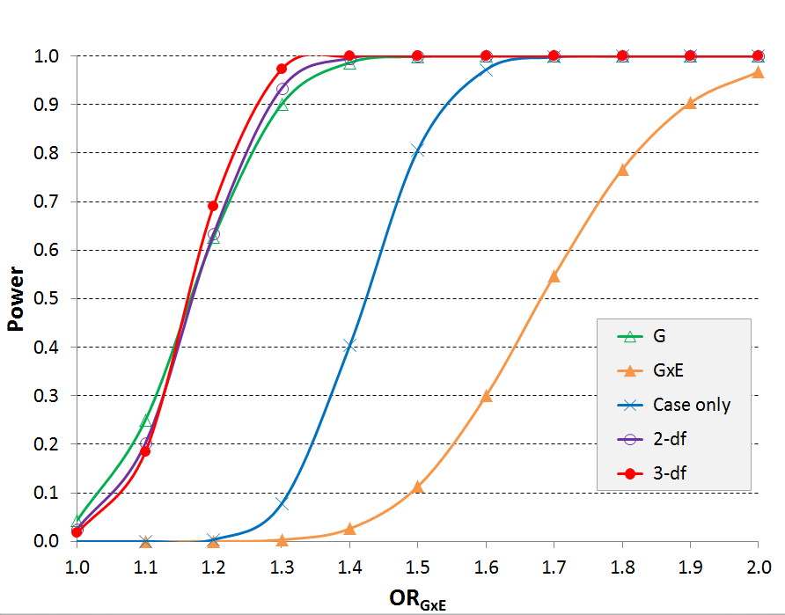
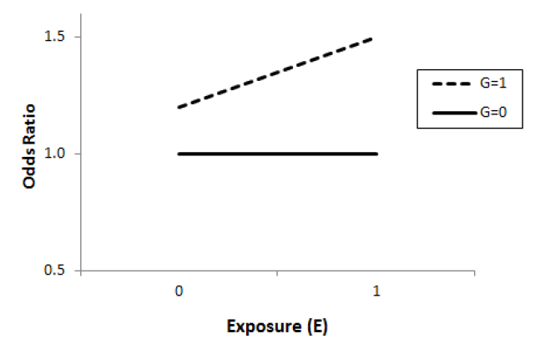
Pure GxE
Quantitative GxE

Slide 53
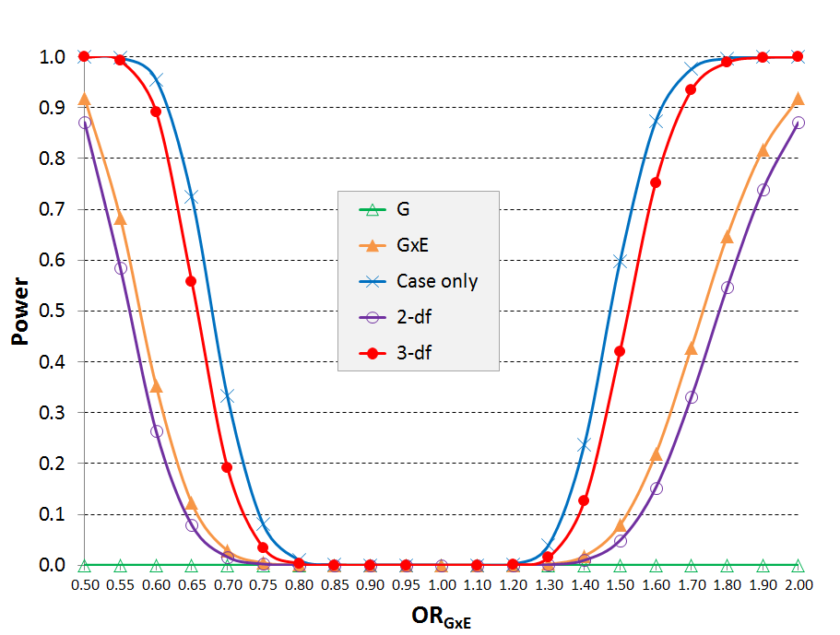
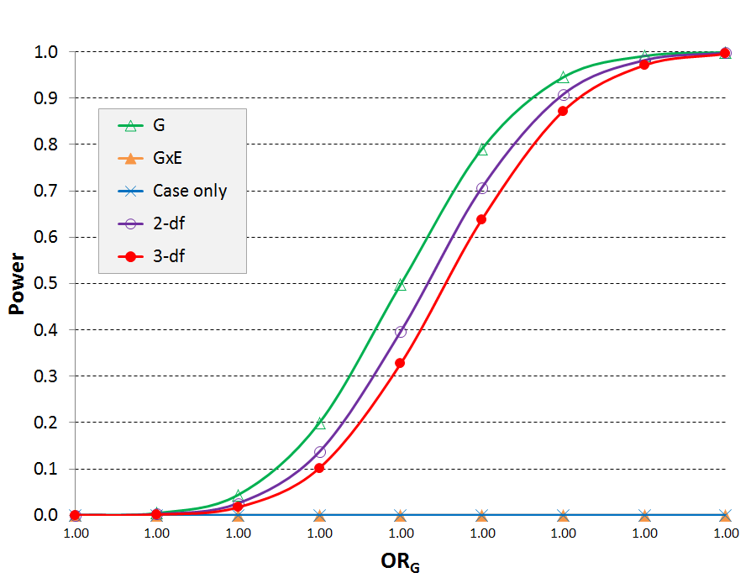
Qualitative GxE
No GxE

Slide 54
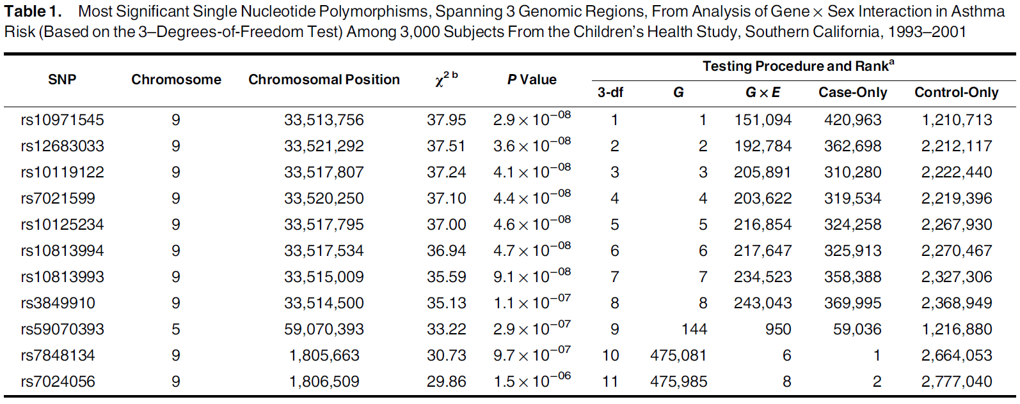
G x Sex interaction scan for asthma in the CHS (1,249 cases, 1751 controls)

Slide 55
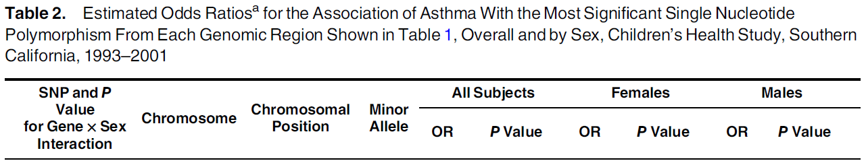
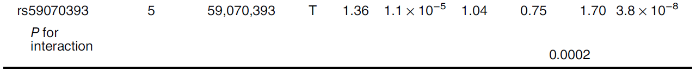
Sex-specific effects: Chr 5 SNP
SNP is in the PDE4D locus, a known asthma gene

Slide 56



BinaryDosage + GxEscanR: Software for GWIS
(Morrison, Gauderman: on CRAN)
Measured or Imputed Genotypes (.GEN or .VCF)
(BinaryDosage)
Phenotype (quantitative or disease) and covariates, including ‘E’ (.txt)
GxEscanR
G Only
2-df G, GxE
Disease
Trait
GxE
Case only
E vs. G
3-df
BinaryDosage
GxEscanR
Standard G, GxE, 2-step, joint tests
Notes:
Workhorse driving GWIS
Mention runtimes for GWIS

Slide 57
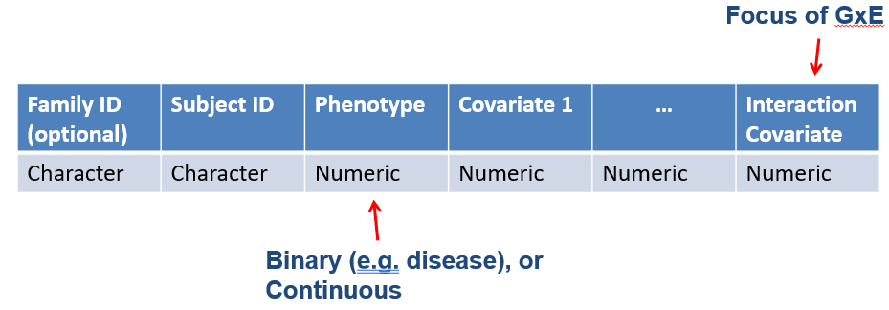
Input Data
Subject Data Format:
Genotype Data: Pre-process using BinaryDosage
Reads raw genotype data and creates binary file for fast downstream analysis
Handy utilities for descriptive summaries (e.g. getmaf)

Slide 58
Speed Comparison (Conducted by U. Washington)
R-Only Program
25 CPU’s * 33.7 hours = 842.5 CPU hours
BinaryDosage + GxEScanR
1 CPU * 5.6 hours = 5.6 CPU hours
Relative Speed: 150

Slide 59
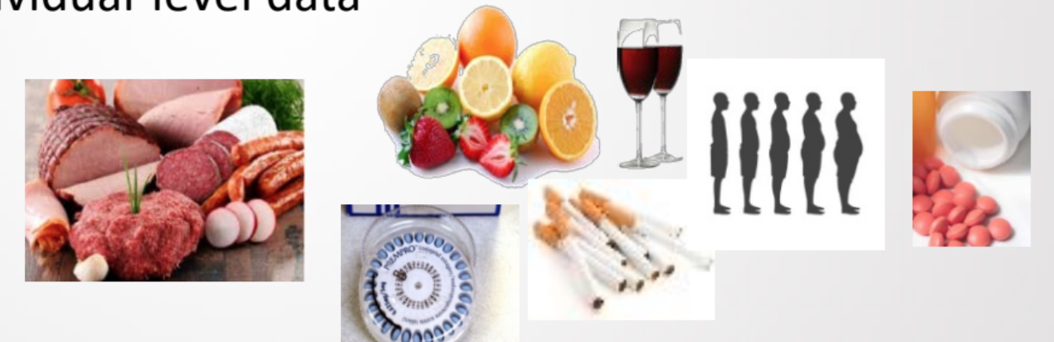
Functionally-Informed Gene-Environment Interactions (FIGI) (MPI: Peters, Gauderman, Casey, LeMarchand)
Consortium of 62 studies
60K+ colorectal cancer cases and 70K+ controls
30M imputed SNPs
Harmonized data on 14 established risk factors
2-step and joint tests for GxE

Slide 60
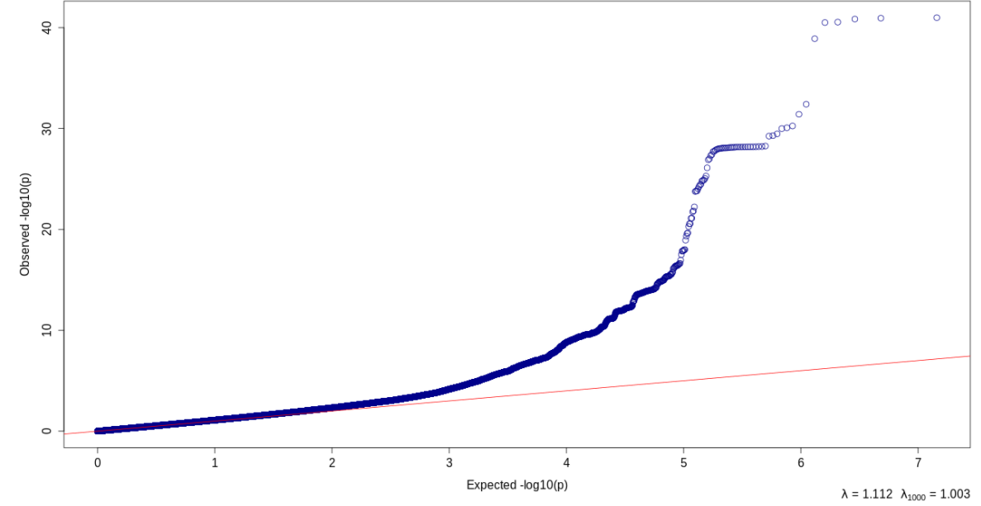
GWAS scan for CRC: G main effect
Logit[Pr(D=1 | G) = μ₀ + μ_{G}G + γC
C: covariates sex, age, ancestry, study site
>100 SNPs associated with colorectal cancer

Slide 61
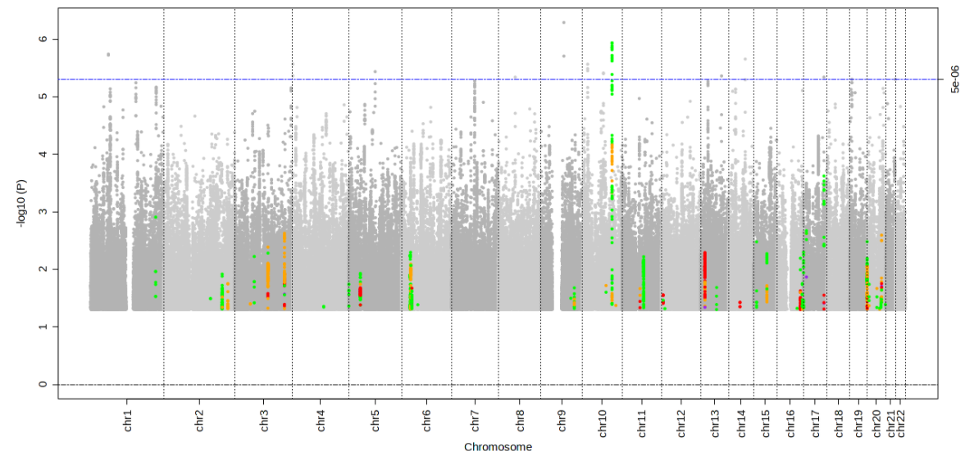
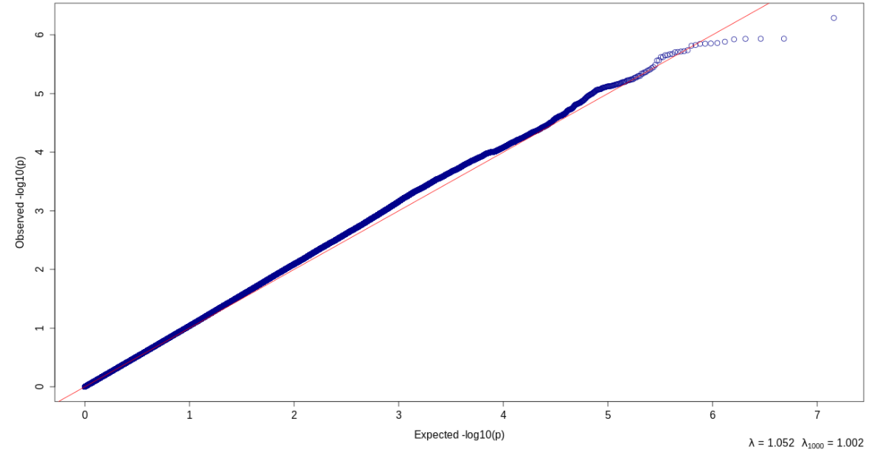
GWIS scan for CRC: G x alcohol (1-28g/day) (Jorhahl et al., 2022)
Logit[Pr(D=1 | G) = β₀ + β_{G}G + β_{E}E + β_{GxE}GxE + γ C
No SNPs with GxE significant at 5 x 10⁻⁸

Slide 62
GWIS scan for CRC: G x alcohol (1-28g/day)
2-step Method

Slide 63
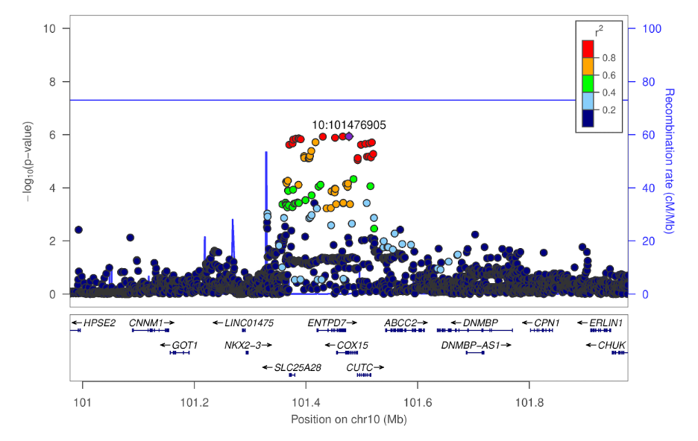
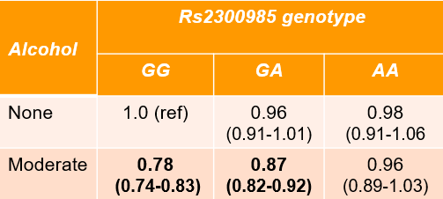
GWIS scan for CRC: G x alcohol
A protective effect of moderate alcohol consumption:
OR=0.87 for GA genotype
OR=0.78 for GG genotype

Slide 64
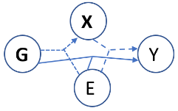
Integrating Omic Data into GxE Analysis
X: Expression, metabolomics, microbiome, methylation, etc.
X may be measured...
In the main sample (all N or a subset) or in a separate sample
In one tissue or multiple tissues
At one time or longitudinally

Slide 65
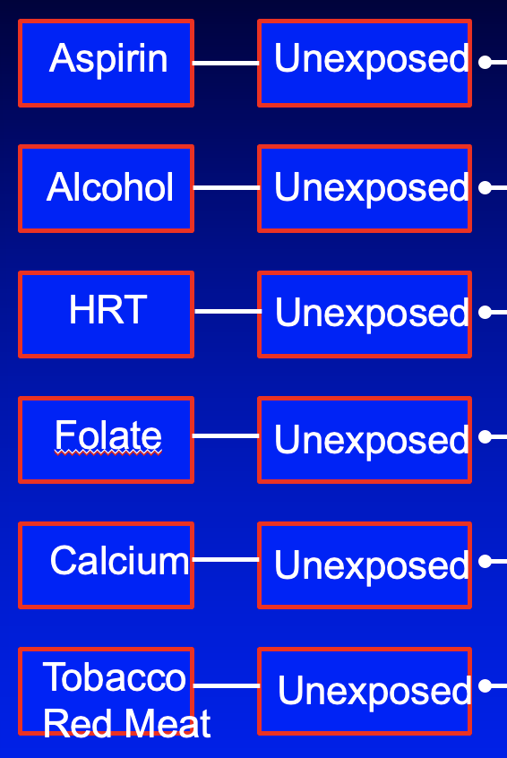

Additional Expression Data: FIGI
445 normal colon biopsies with expression (M), past exposures (E), and genotype (G) data. (“BarcUVa” study) (Diez–Obrero et al., CMGH 2021;12:181)
~34 normal colon crypts with expression (M), experimental exposure (E), and genotype (G) data. (Devall et al., Sci Reps 2021; 11: 432)
N=34 pairs

Slide 66



G x Expression using BarcUVa Data
N=445 BarcUVa samples used to generate eQTL models for Cox15 and ENTPD7
Using those models, predict expression ( ) in N ~102,000 FIGI subjects
Does predicted expression interact with alcohol to affect CRC risk?
Cox15
ENTPD7
( – Median)/IQR
( – Median)/IQR

Slide 67
FIGI: Expression x Alcohol scan (Jorhahl et al., 2022)
 | lnOR coefficients (SE)
 | COX15 | ENTP7
Alcohol consumption (relative to none)
moderate | -0.12 (0.02)** | -0.14 (0.02)**
heavy | 0.18 (0.03)** | 0.18 (0.03)**
Standardized predicted expression* | 0.002 (0.019) | -0.003 (0.015)
Expression x alcohol interaction
moderate | -0.11 (0.03)** | -0.06 (0.02)*
heavy | -0.02 (0.04) | -0.03 (0.03)
Moderate alcohol is protective for those at median of gene expression
Moderate alcohol has greater protective effect with increased gene expression
* P < 0.005; ** p < 0.0001
Notes:
PTGER4 is a important for the biological mechanism of action of aspirin. Unfortunately however, eQTL looks up of this markers (+ LD SNPs Rsq > 0.5) didn’t yield any significant findings. There IS an eQTL in GTEx v8 with PTGER4, but the finding is for “(Skin_Not_Sun_Exposed_Suprapubic)”

Slide 68
FIGI: Expression x Alcohol scan (Jorhahl et al., 2022)
 | lnOR coefficients (SE)
 | COX15 | ENTP7
Alcohol consumption (relative to none)
moderate | -0.12 (0.02)** | -0.14 (0.02)**
heavy | 0.18 (0.03)** | 0.18 (0.03)**
Standardized predicted expression* | 0.002 (0.019) | -0.003 (0.015)
Expression x alcohol interaction
moderate | -0.11 (0.03)** | -0.06 (0.02)*
heavy | -0.02 (0.04) | -0.03 (0.03)
Heavy alcohol (29+ g/day) is risk factor
No evidence for Expression x Heavy interaction
* P < 0.005; ** p < 0.0001
Notes:
PTGER4 is a important for the biological mechanism of action of aspirin. Unfortunately however, eQTL looks up of this markers (+ LD SNPs Rsq > 0.5) didn’t yield any significant findings. There IS an eQTL in GTEx v8 with PTGER4, but the finding is for “(Skin_Not_Sun_Exposed_Suprapubic)”

Slide 69

FIGI Ethanol Organoid Experiment Differential expression (X) in N=34 matched pairs: exposed v. control (E)
DEG’s with increased expression following ethanol exposure include genes in pathways related to ethanol and colonic neoplasms
Devall et al., Sci Reps 2021; 11: 432
Notes:
FSTL3: Follistatin like-3 (FSTL3) is a potent inhibitor that antagonizes TGF-β family ligands

Slide 70
Putting it All Together
G × E → X?
X × E → Y?
G × E → Y (informed by X)?
Analysis approaches?
Modified 2-step and/or multi-df tests
Hierarchical models
Accommodating multiple sources of X (e.g. BarcUVa, GTex)
Methods work is ongoing …

Slide 71
GxE Lecture 1 Summary
GxE analysis holds promise for discovering novel loci
No ‘universally’ most powerful method…
…But power can be improved by using additional information
2-step methods
2-df and 3-df tests
Further potential to increase power by integrating expression or other ‘omic’ data (work in progress)
Pairing methods with software is key…time to practice in LAB #1

